Slide 1
Permaculture Principles masterclass
Steve Burns
Presentation Date
Notes:
This template can be used as a starter file for presenting training materials in a group setting.
Sections
Right-click on a slide to add sections. Sections can help to organize your slides or facilitate collaboration between multiple authors.
Notes
Use the Notes section for delivery notes or to provide additional details for the audience. View these notes in Presentation View during your presentation.
Keep in mind the font size (important for accessibility, visibility, videotaping, and online production)
Coordinated colors
Pay particular attention to the graphs, charts, and text boxes.
Consider that attendees will print in black and white or grayscale. Run a test print to make sure your colors work when printed in pure black and white and grayscale.
Graphics, tables, and graphs
Keep it simple: If possible, use consistent, non-distracting styles and colors.
Label all graphs and tables.

Slide 2
Steve Burns
1978 presentation
Permaculture Design Courses 2000, 2009
Chestnut Farm
Ballarat Permaculture Guild
Attended 2005 Advanced PC principles course in Bolinas, California (4 day residential)
Assisted David Holmgren with subsequent course deliveries in Australia
Notes:
Steve introduces himself and explains how the course was developed.
A word about design:
In permaculture, we aren’t seeking design principles to impose on the world; we are looking to observe the design principles inherent in the world. In a way, we are deliberating seeking to be ‘un-original’; we’re not trying to invent anything, but rather find the easiest way to observe what we see around us.
There is a saying that “Good design is invisible, but bad design smacks you in the face” What do you think that means? [Good design applies principles that ‘fit’ the context, so they feel right and aren’t noticed; bad design imposes external, inappropriate principles to a context and the clash of the design approach in the context is immediately apparent]

Slide 3
Brief History of PC Principles
Permaculture One
Early permaculture teachers individual sets
Permaculture Design Course
An open conversation rather than a set of principles set in stone
“Permaculture: Principles & Pathways beyond Sustainability” (2002)
Permaculture Principles website
Notes:
PC One: principles implicit, rather than explicitly listed
Led to confusion/ambiguity so some PC teachers started to develop their own lists
Different people had different lists; leading to confusion amongst students and the public
Principles & pathways not the definitive statement, but a significant contribution to the conversation

Slide 4

New Work
Notes:
This is another option for an Overview slides using transitions.

Slide 5
New Environment

Slide 6

New Colleagues

Slide 7


Welcome

Slide 8
Today’s Overview
1
Apply the principles together
3
Questions
Explore individual principles
2
Notes:
This is another option for an Overview slide.

Slide 9
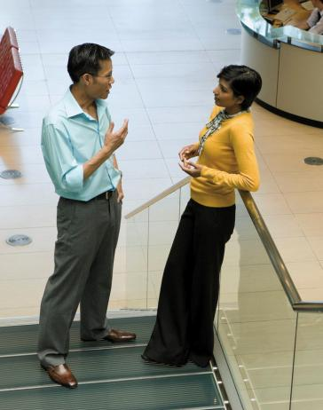
Learning Objectives
Technology
Procedure
Policies
Benefits
Notes:
What will the audience be able to do after this training is complete? Briefly describe each objective how the audience will benefit from this presentation.

Slide 10
New Work
Notes:
Use a section header for each of the topics, so there is a clear transition to the audience.

Slide 11
New Work
The technology learning curve
Notes:
Add slides to each topic section as necessary, including slides with tables, graphs, and images.
See next section for sample table, graph, image, and video layouts.

Slide 12
Who’s Who
Lead | Contact information
Jim | Jim@company.com
Dee | Dee@gcompany.com
Mavis | Mavis@company.com
Doug | Doug@company.com
Notes:
Keep it brief. Make your text as brief as possible to maintain a larger font size.

Slide 13
Working Toward Mastery
Achieve Mastery
Get Experienced
Projects Worked On
Get Familiar
Time Spent

Slide 14

Doing Your Best Work
Working from home
Working offsite
Technology requirements
Notes:
If there is relevant video content, such as a case study video, demo of a product, or other training materials, include it in the presentation as well.

Slide 15

Case Study
Jeremy
  His first day
  Mistakes made
  Successes achieved
  The moral of the story
Notes:
Add a case study or class simulation to encourage discussion and apply lessons.

Slide 16
Discussion
What we can learn from Jeremy
Best practices
Take-aways
Notes:
Discuss outcomes of the case study or class simulation.
Cover best practices.

Slide 17
Summary
Define your challenges
  Technological as well as personal
Set realistic expectation
  Mastery is not achieved overnight
Keep your eye on the goal
  Mentorship programs
Notes:
Summarize presentation content by restating the important points from the lessons.
What do you want the audience to remember when they leave your presentation?
Save your presentation to a video for easy distribution (To create a video, click the File tab, and then click Share. Under File Types, click Create a Video.)

Slide 18
Resources
<Intranet site text here>
<hyperlink here>
<Additional reading material text here>
<hyperlink here>
This slide deck and related resources:
<hyperlink here>

Slide 19
Questions?

Slide 20
Appendix
Notes:
Is your presentation as crisp as possible? Consider moving extra content to the appendix.
Use appendix slides to store content that you might want to refer to during the Question slide or that may be useful for attendees to investigate deeper in the future.

